Slide 1
16 Days

Slide 2
The Origin of Human Life

Slide 3
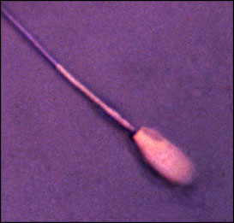
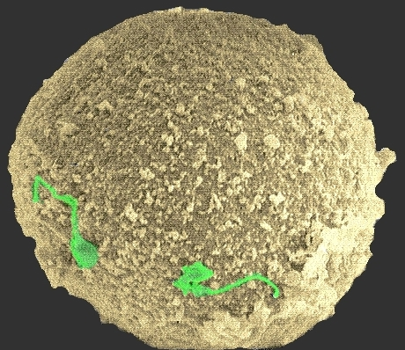
first there are two:
t₁

Slide 4
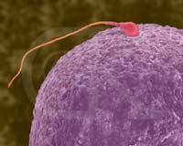
t₂

Slide 5
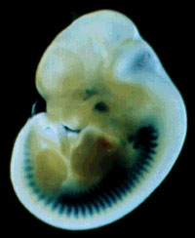
but somewhere along the way there is one
t₃

Slide 6
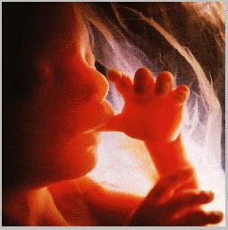
t₄

Slide 7
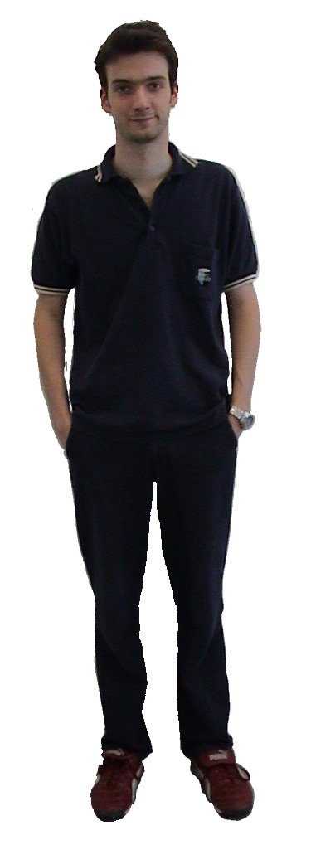
t₅

Slide 8
t₆

Slide 9
t₇

Slide 10
t₈

Slide 11
a. single-cell zygote (day 0)
b: multi-cell zygote (days 0-3)
c. morula (day 3)
d. early blastocyst (day 4)
e. implantation (days 6-13)
f. gastrulation (days 14-16)
g. neurulation (from day 16)
h. formation of the brain stem (days 40-43)
i. end of first trimester (day 98)
j. viability (around day 130)
k. sentience (around day 140)
l. quickening (around day 150)
m. birth (day 266)
n. the development of self-consciousness (some time after birth)

Slide 12
Alternative thresholds for substantial change
single-cell zygote
‘human life deserves protection’
vs. ‘human beings deserve protection’

Slide 13
a. single-cell zygote (day 0)
b: multi-cell zygote (days 0-3)
c. morula (day 3)
d. early blastocyst (day 4)
e. implantation (days 6-13)
f. gastrulation (days 14-16)
g. neurulation (from day 16)
h. formation of the brain stem (days 40-43)
i. end of first trimester (day 98)
j. viability (around day 130)
k. sentience (around day 140)
l. quickening (around day 150)
m. birth (day 266)
n. the development of self-consciousness (some time after birth)

Slide 14
The thesis
‘human being’, ‘human individual’, ‘human organism’ are all synonyms
a substantial change occurs at the latest 16 days after fertilization
and as a result of this substantial change a human being comes into existence

Slide 15
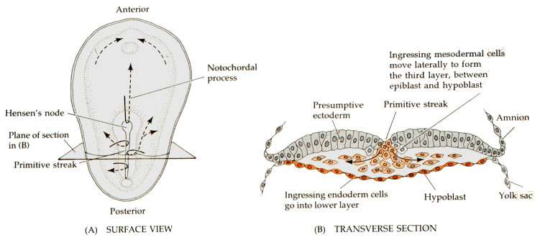
Gastrulation
eatworms.swmed.edu/~leon/med_neuro/neurogenesis.ppt

Slide 16
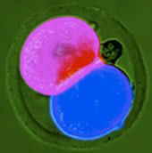
early mammalian embryos
are not featureless bundles of cells – since they contain already the programming for gastrulation

Slide 17
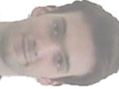
But then Daniel doesn’t want to save life after all:
… isn't it implausible to want to protect human life?
Even a cut-off finger would be deserving of protection. …
Early fosters are morally nearly on a par with cut-off fingers. …
… blah blah blah

Slide 18
Substantial changes must be instantaneous
Compare:
two drops of water flow together and become one
an ameoba splits and becomes two

Slide 19
The process of becoming a person
is not instantaneous
whatever comes into existence when a person comes into existence is not a substance

Slide 20
Rather
it is something like a new quality or a new capacity
‘person’, like ‘student’ is a phase sortal
but then the question remains: what is the substance which underlies this quality or capacity?
and when does it begin to exist?

